Slide 1

Submitted by
Name: Nushrat Jaben Aurnima
ID: 2022-2-60-146
Name: Shairin Akter Hashi
ID: 2022-2-60-102
Name: MD Shahrukh Hossain Shihab
ID: 2022-1-60-372
Name: Zihad Khan
ID: 2022-2-60-107
Machine Learning
Semester: Summer 2025
CSE475, Section:2
Submitted to
Dr. Raihan Ul Islam, Associate Professor
Department of Computer Science and Engineering

Slide 2
Objectives
Evaluate the performance of SSL frameworks (SimCLR, BYOL, MoCo v2) on the EuroSAT dataset using different backbone networks (ResNet-50, DenseNet-121, EfficientNet-B3).
Identify the most effective SSL framework–backbone combination for achieving high accuracy and stability in satellite image classification.

Slide 3
Dataset
EuroSAT dataset: has 27,000 labeled images (10 land use & land cover classes: AnnualCrop, Forest, Herbaceous Vegetation, Highway, Industrial, Pasture, PermanentCrop, Residential, River, SeaLake)
Resolution: Each image 64×64 pixels (resized to 224×224 for training)
Preprocessing: Normalization (ImageNet mean & std), data augmentations (random crop, flip, blur, color jitter, grayscale)
Split: Train (70%), Validation (20%), Test (10%)

Slide 4
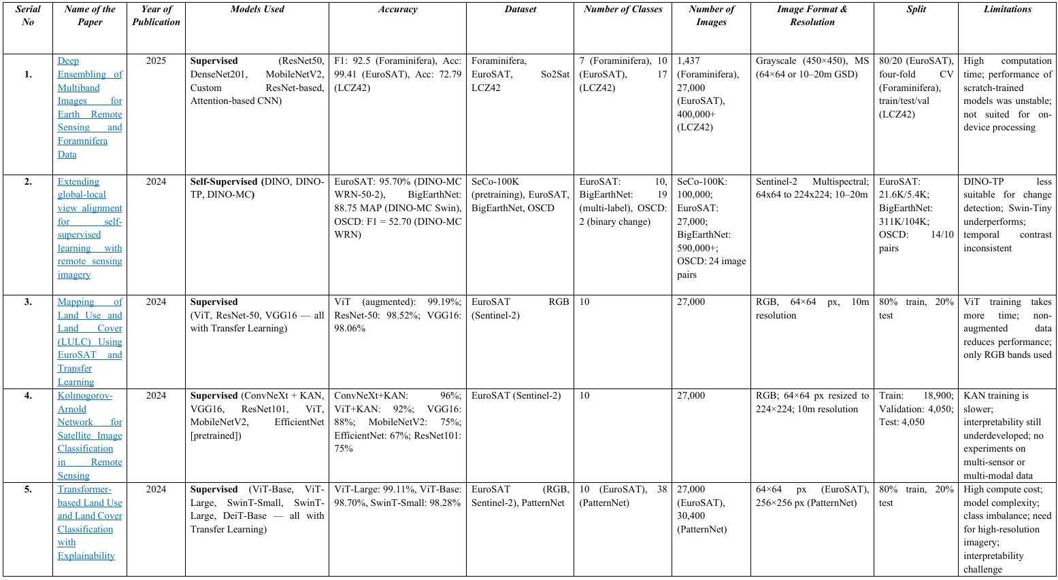
Related works

Slide 5
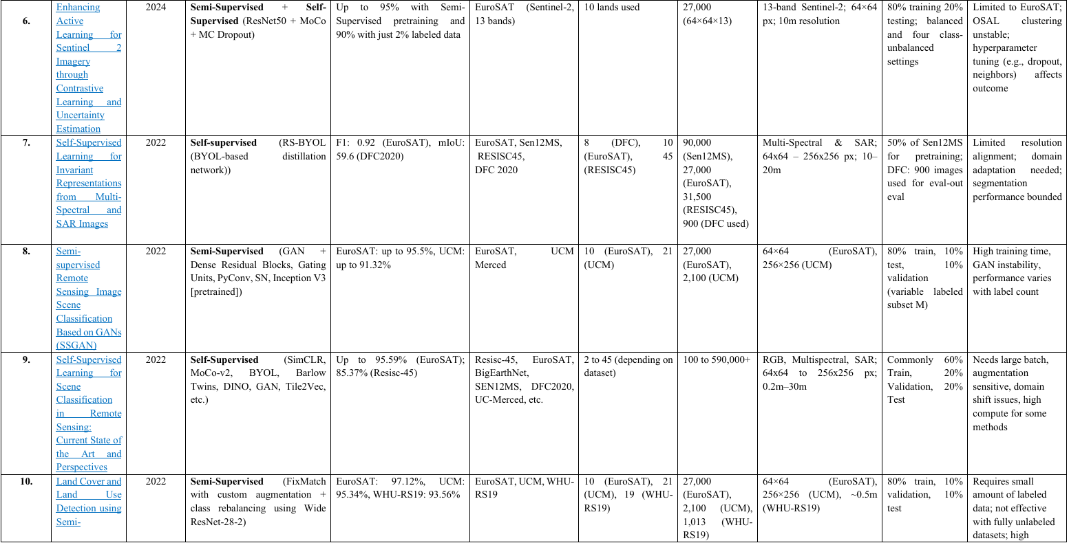
Related works

Slide 6
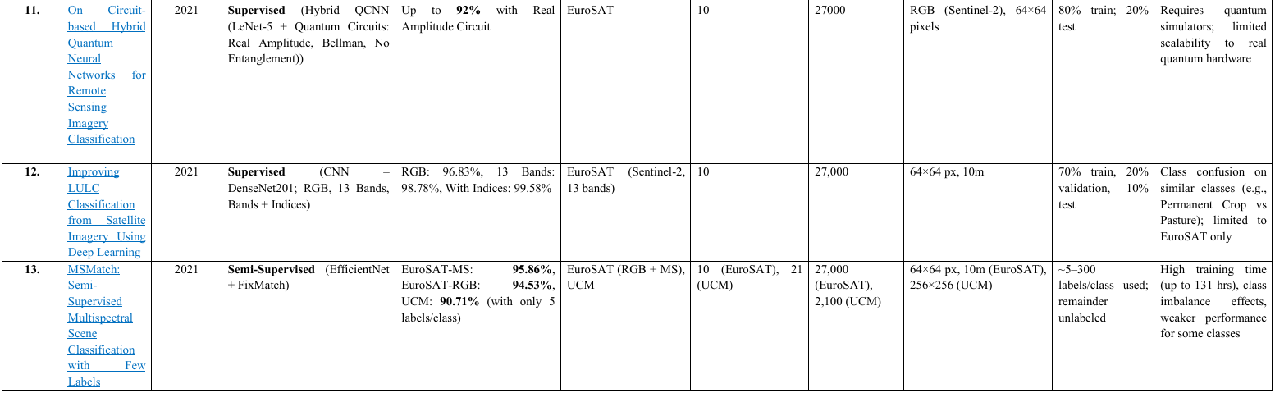
Related works

Slide 7
Model Architectures
a. SimCLR (contrastive learning with positives and negatives) b. BYOL (positive pair consistency, no negatives) c. MoCo v2 (momentum encoder, dynamic negative queue) d. Backbones: ResNet-50, DenseNet-121, EfficientNet-B3

Slide 8
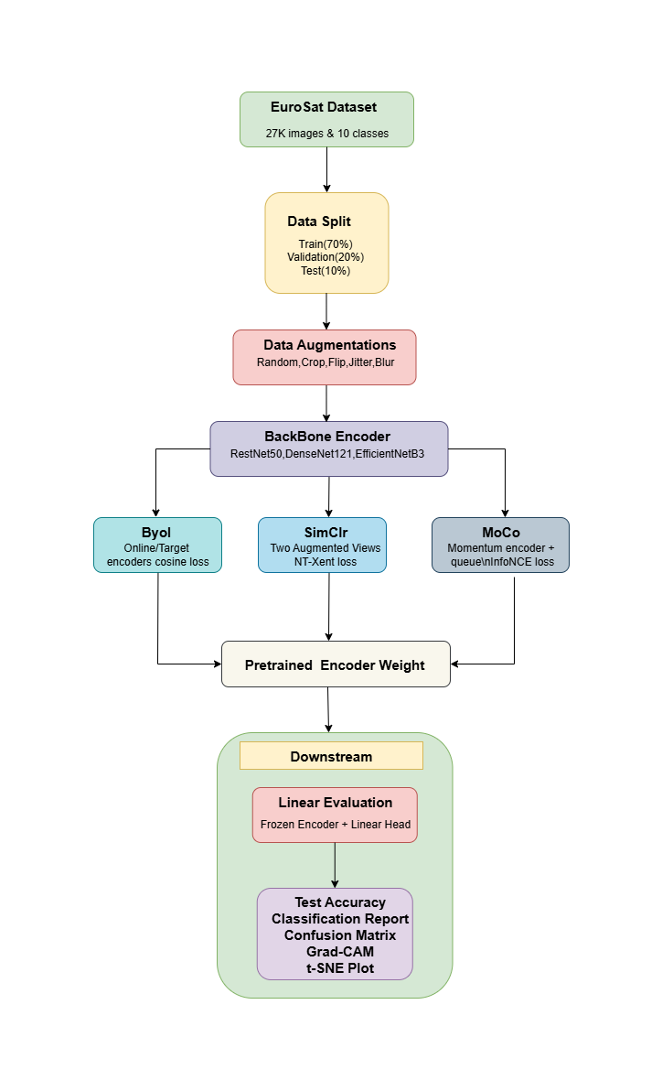
Workflow Diagram

Slide 9
Model Training Parameters
Batch size: 64
Optimizer: AdamW
Learning rate: 3e-4 (pretrain), 1e-3 (linear eval)
Cosine scheduler with warm-up
Epochs: 100, 300, 400, 500

Slide 10
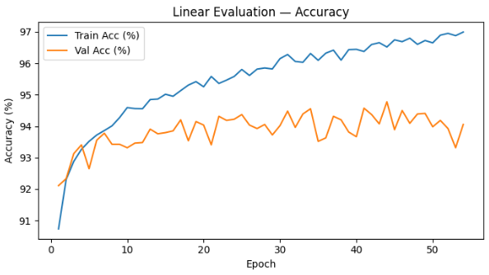
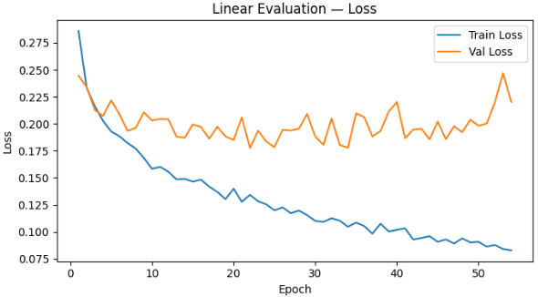
All Models Learning Curves
SimCLR (ResNet-50) Accuracy & Loss Curves

Slide 11
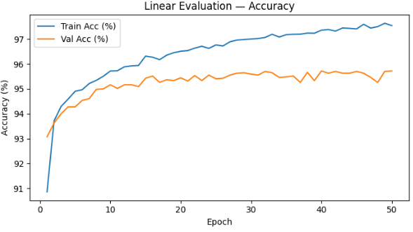
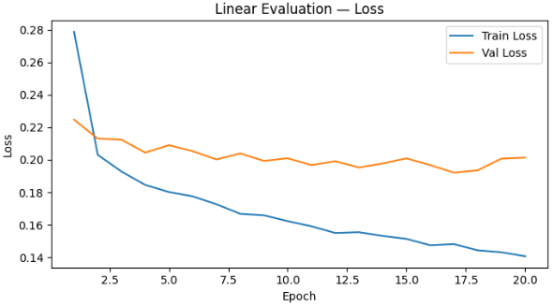
All Models Learning Curves
SimCLR (DenseNet-121) Accuracy & Loss Curves

Slide 12
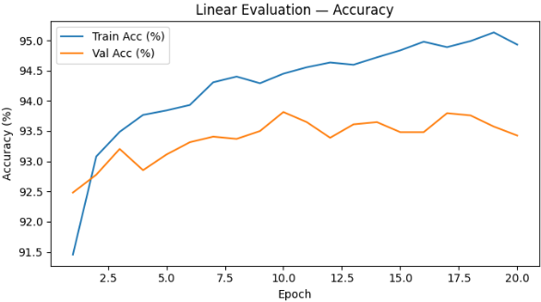
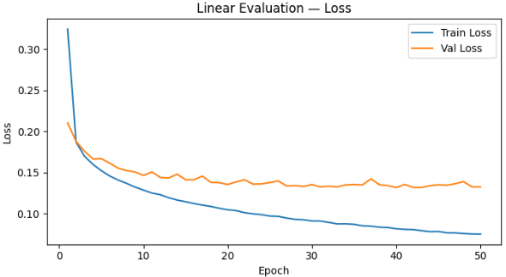
All Models Learning Curves
SimCLR (EfficientNet-B3)Accuracy & Loss Curves

Slide 13
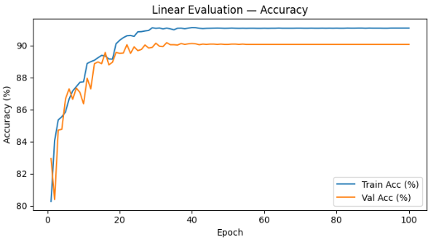
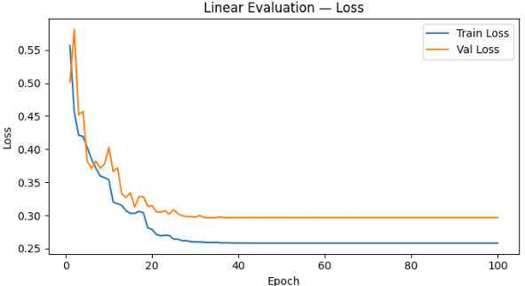
All Models Learning Curves
Byol (ResNet-50) Accuracy & Loss Curves

Slide 14
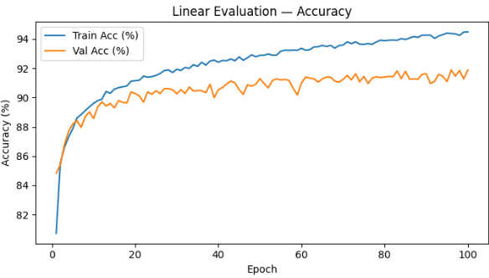
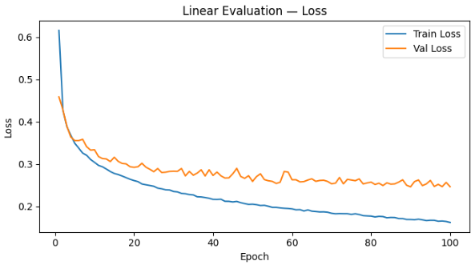
All Models Learning Curves
Byol (DenseNet-121) Accuracy & Loss Curves

Slide 15
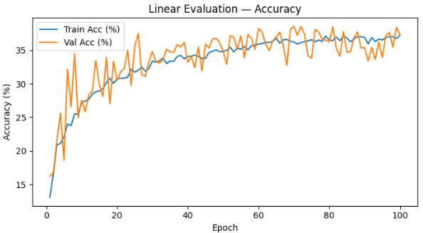
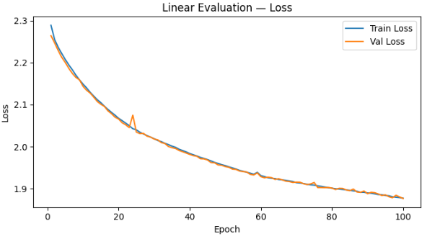
All Models Learning Curves
Byol (EfficientNet-B3) Accuracy & Loss Curves

Slide 16
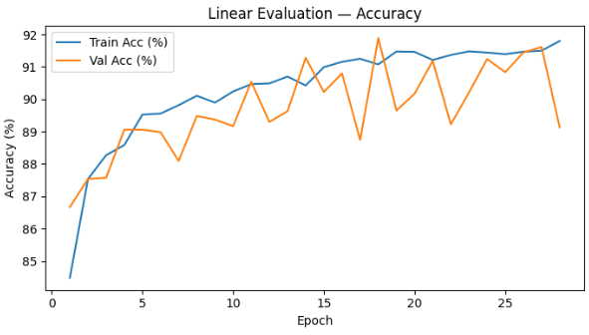
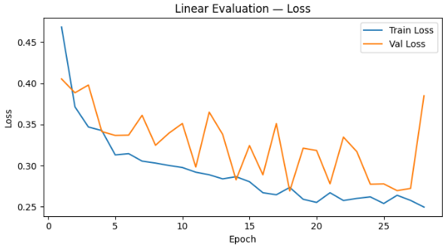
All Models Learning Curves
Moco v2 (ResNet-50) Accuracy & Loss Curves

Slide 17
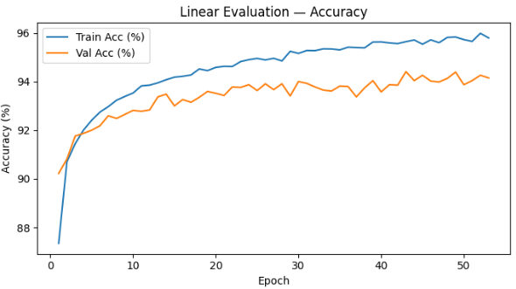
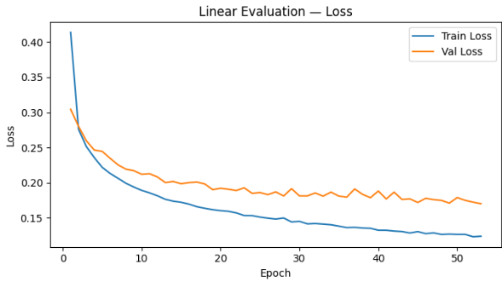
All Models Learning Curves
Moco v2 (DenseNet-121)Accuracy & Loss Curves

Slide 18
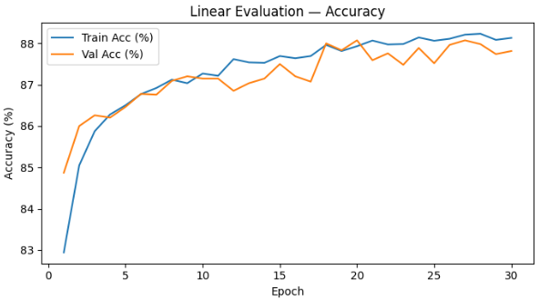
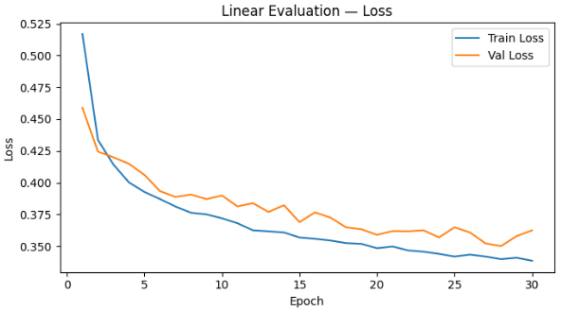
All Models Learning Curves
Moco v2 (EfficientNet-B3) Accuracy & Loss Curves

Slide 19
Performance Table
Model | Backbones | Accuracy | Precision | Recall | F1-score | Epochs
SimCLR | EfficientNet-B3 | 94.15% | 0.9400 | 0.9390 | 0.9390 | 100
SimCLR | DenseNet-121 | 96.63% | 0.9650 | 0.9650 | 0.9650 | 100
SimCLR | ResNet-50 | 95.30% | 0.9500 | 0.9510 | 0.9510 | 100
BYOL | DenseNet-121 | 92.41% | 0.9203 | 0.9214 | 0.9202 | 100
BYOL | EfficientNet-B3 | 38.74% | 0.3098 | 0.3609 | 0.3099 | 100
BYOL | ResNet-50 | 91.19% | 0.9074 | 0.9081 | 0.9075 | 100
MoCo v2 | DenseNet-121 | 94.81% | 0.9464 | 0.9460 | 0.9459 | 100
MoCo v2 | EfficientNet-B3 | 88.78% | 0.8810 | 0.8826 | 0.8811 | 100
MoCo v2 | ResNet-50 | 92.07% | 0.9185 | 0.9169 | 0.9170 | 100
94.67%

Slide 20
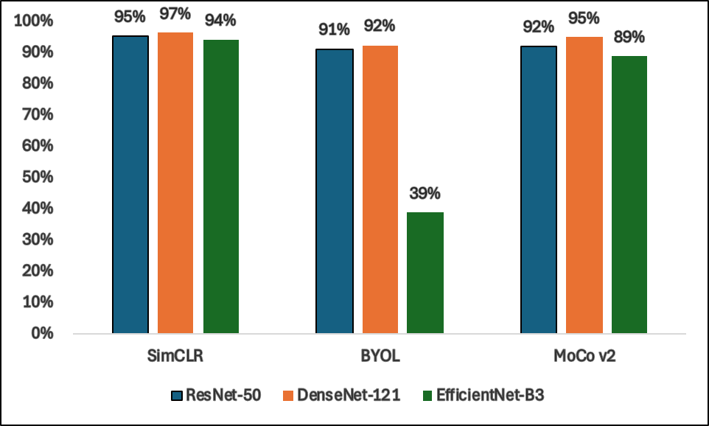
Performance Comparison
The graph shows that DenseNet-121 typically outperformed all the other backbones, while EfficientNet-B3 performed poorly in BYOL. The best result, SimCLR with DenseNet-121 (96.63%), highlighted how dense connectivity strengthens features representation and improves classifications.

Slide 21
Conclusion
The study compared SimCLR, MoCo v2, and BYOL with several backbones. SimCLR achieved the best accuracy at 96.63%, with MoCo v2 performing well too. BYOL was generally stable with ResNet-50 and DenseNet-121, and weaker with EfficientNet-B3, showing the importance of the backbone. The results indicate that SSL can support high-quality satellite image classification without significant interaction costs for the labeling, and there are high future prospects for transformers, multi-dimensional imagery like hyperspectral, and cross-sensor transfer.

Slide 22
Thank you

